Slide 1
Properties of
Regular Languages

Slide 2




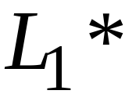
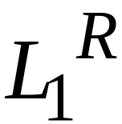


For regular languages and
we will prove that:
Union:
Concatenation:
Are regular
Languages
Star:
Reversal:
Complement:
Intersection:
Courtesy Costas Busch - RPI

Slide 3
A useful transformation: use one accept state
Any NFA can be converted
to an equivalent NFA
with a single final state
Courtesy Costas Busch - RPI

Slide 4



Example
NFA
Equivalent NFA
Courtesy Costas Busch - RPI

Slide 5
In General
NFA
Equivalent NFA
Single
final state
Courtesy Costas Busch - RPI

Slide 6
Extreme Case
NFA without final state
Add a final state
Without transitions
Courtesy Costas Busch - RPI

Slide 7
We say: Regular languages are closed under
Union:
Concatenation:
Star:
Reversal:
Complement:
Intersection:
Courtesy Costas Busch - RPI

Slide 8
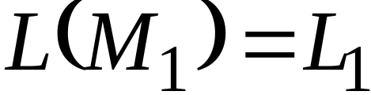
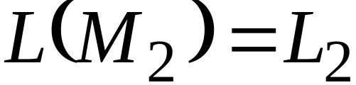


Let us take two languages
Regular language
Regular language
NFA
NFA
Single final state
Single final state
Courtesy Costas Busch - RPI

Slide 9

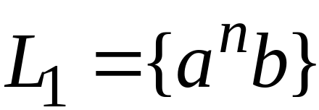
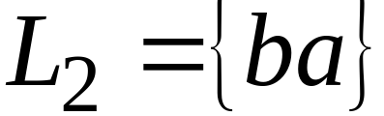
Example
Courtesy Costas Busch - RPI

Slide 10
Show Regular languages are closed under
Union:
Concatenation:
Star:
HOW?
Reversal:
Complement:
Intersection:
Courtesy Costas Busch - RPI

Slide 11
Union
NFA for
Courtesy Costas Busch - RPI

Slide 12
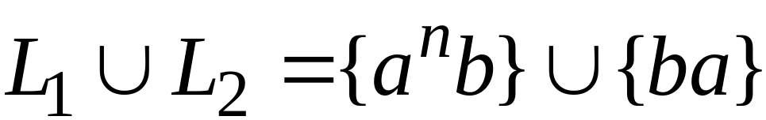
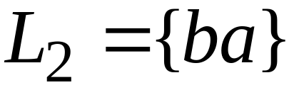
Example
NFA for
Courtesy Costas Busch - RPI

Slide 13
Show Regular languages are closed under
Union:
Concatenation:
Star:
HOW?
Reversal:
Complement:
Intersection:
Courtesy Costas Busch - RPI

Slide 14
Concatenation
NFA for
Courtesy Costas Busch - RPI

Slide 15
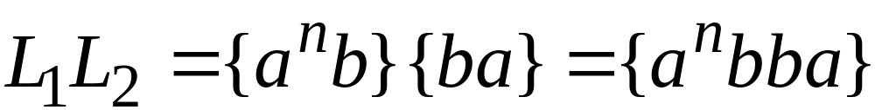
Example
NFA for
Courtesy Costas Busch - RPI

Slide 16
Show Regular languages are closed under
Union:
Concatenation:
Star:
HOW?
Reversal:
Complement:
Intersection:
Courtesy Costas Busch - RPI

Slide 17
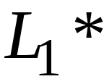
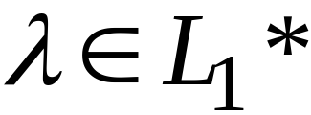
Star Operation
NFA for
Courtesy Costas Busch - RPI

Slide 18
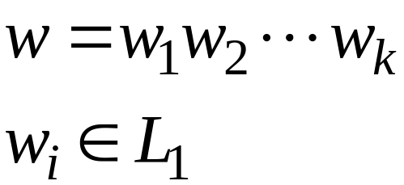
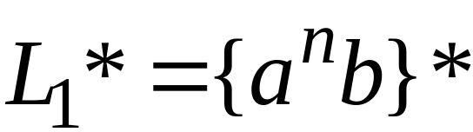
Example
NFA for
Courtesy Costas Busch - RPI

Slide 19
Show Regular languages are closed under
Union:
Concatenation:
Star:
HOW?
Reversal:
Complement:
Intersection:
Courtesy Costas Busch - RPI

Slide 20

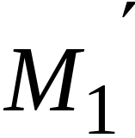
Reverse
NFA for
1. Reverse all transitions
2. Make initial state final state
and vice versa
Courtesy Costas Busch - RPI

Slide 21
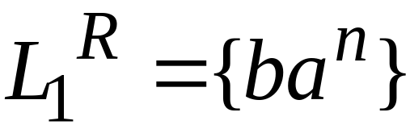
Example
Courtesy Costas Busch - RPI

Slide 22
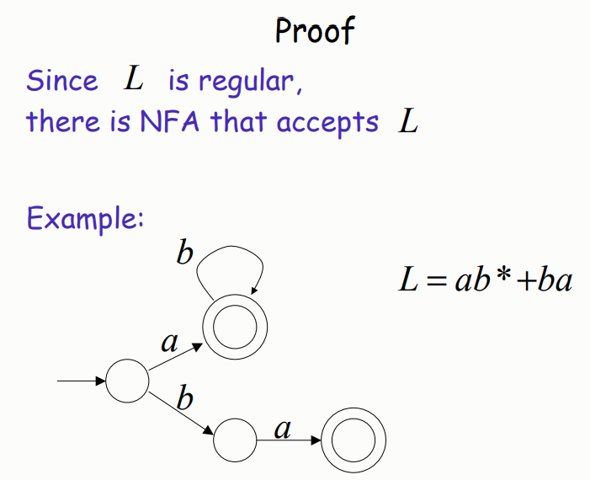
Courtesy Costas Busch - RPI

Slide 23
Show Regular languages are closed under
Union:
Concatenation:
Star:
HOW?
Reversal:
Complement:
Intersection:
Courtesy Costas Busch - RPI

Slide 24
Complement
1. Take the DFA that accepts
2. Make final states non-final,
and vice-versa
Courtesy Costas Busch - RPI

Slide 25

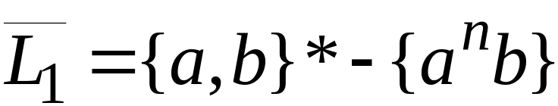
Example
Courtesy Costas Busch - RPI

Slide 26
Show Regular languages are closed under
Union:
Concatenation:
Star:
HOW?
Reversal:
Complement:
Intersection:
Courtesy Costas Busch - RPI

Slide 27
Intersection
regular
We show
regular
regular
Courtesy Costas Busch - RPI

Slide 28

Proof for Intersection Closure
Machine
Machine
DFA
for
DFA
for
Construct a new DFA that accepts
simulates in parallel and
Courtesy Costas Busch - RPI

Slide 29


simulates in parallel and
accepts string
if and only if:
accepts string
and accepts string
Courtesy Costas Busch - RPI

Slide 30




Another Proof for Intersection Closure
DeMorgan’s Law:
regular
regular
regular
regular
regular
Courtesy Costas Busch - RPI

Slide 31
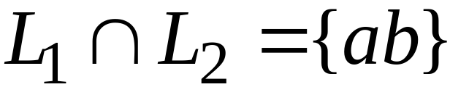
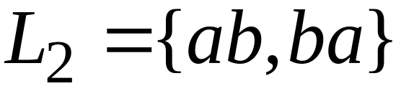
Example
regular
regular
regular
Courtesy Costas Busch - RPI

